Slide 1

Big Data Analysis with IBM Cloud Databases
Problem Definition And Design Thinking
This Photo by Unknown author is licensed under CC BY.

Slide 2

Abstract
."Unlocking Insights from Extensive Datasets: Big Data Analysis with IBM Cloud Databases" explores the comprehensive process of harnessing the power of big data through IBM Cloud Databases. This project delves into the design, setup, and execution of data analysis on diverse datasets, encompassing climate trends and social patterns. The presentation highlights the crucial steps of designing the analysis process, configuring IBM Cloud Databases, and employing data analysis techniques, including machine learning and statistical methods. The results are translated into meaningful visualizations that empower business intelligence. Case studies showcase practical applications, and the project concludes with recommendations for decision-makers, offering a roadmap for extracting valuable insights from large-scale data.

Slide 3

Problem Definition
In an era of data abundance, organizations face the challenge of extracting actionable insights from vast and diverse datasets spanning climate trends and social patterns. Leveraging IBM Cloud Databases, this project aims to establish a streamlined process for efficient data analysis. The primary problem is to design a robust analysis framework, configure and optimize IBM Cloud Databases for data storage and retrieval, apply advanced analytics techniques to unearth valuable insights, and transform these findings into visually compelling representations for informed decision-making in the realm of business intelligence.

Slide 4
Design Thinking
Data Selection
Database Setup
Data Exploration
Analysis Techniques
Visualization
Business Insights

Slide 5

Data Selection
Big Data Analysis with IBM Cloud Databases, we have meticulously selected a diverse array of datasets to ensure a comprehensive exploration of various domains. These datasets include climate data, social media trends, economic indicators, healthcare metrics, demographic information, and geospatial data. By incorporating these datasets, we aim to uncover intricate relationships, correlations, and insights that can help businesses, governments, and researchers make data-informed decisions and gain a deeper understanding of the complex interplay between environmental factors, social dynamics, and numerous other influencing variables. These datasets will serve as the bedrock upon which our analytical journey will unfold, unlocking valuable insights from extensive and multifaceted data source

Slide 6

Database Setup
In our project, we leverage the power of IBM Cloud Databases for a robust and scalable database setup. The IBM Cloud Databases platform provides a versatile environment that supports various database types, including relational and NoSQL databases, making it suitable for accommodating diverse data structures. Its seamless integration with cloud resources ensures high availability and scalability, critical for handling extensive datasets. Moreover, IBM Cloud Databases offers robust security features and automated backups, ensuring the integrity and safety of our data throughout the analysis process. This database setup empowers us to efficiently store, access, and manipulate data, laying the foundation for our big data analysis endeavors.
This Photo by Unknown author is licensed under CC BY-SA.

Slide 7

Data Exploration
Data exploration is a critical initial phase in our project of Big Data Analysis with IBM Cloud Databases. It involves the systematic investigation of our extensive datasets to gain an understanding of their structure, quality, and potential insights. This process includes tasks such as data profiling, summary statistics, and visualization to identify patterns, outliers, and correlations within the data. Through data exploration, we aim to uncover initial insights, validate assumptions, and inform subsequent steps in our analysis pipeline. It sets the stage for meaningful feature selection, preprocessing, and the application of advanced analytical techniques, ultimately paving the way for valuable insights and data-driven decision-making.
This Photo by Unknown author is licensed under CC BY.

Slide 8
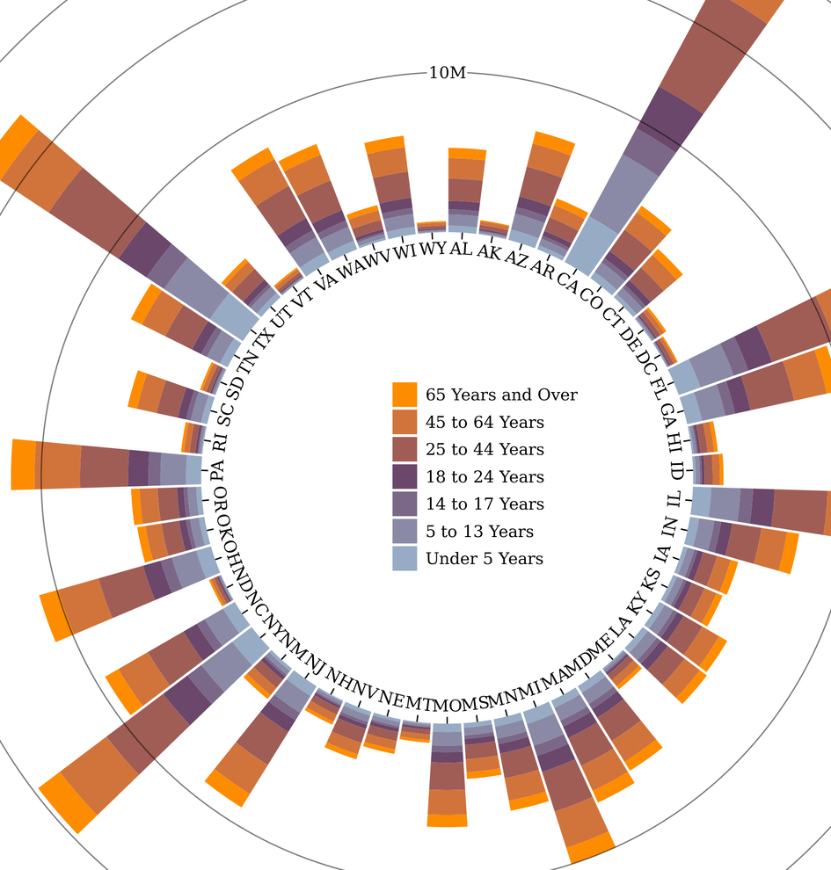
Visualization
In the context of Big Data Analysis with IBM Cloud Databases, visualization plays a pivotal role in transforming raw data into actionable insights. Visualizations, ranging from interactive dashboards to sophisticated data plots, provide a clear and intuitive representation of complex datasets. These visual insights not only simplify the understanding of trends and patterns but also empower decision-makers to make informed choices swiftly. Leveraging IBM Cloud Databases' capabilities alongside advanced visualization tools, our project aims to offer dynamic and visually compelling displays that drive data-driven decision-making, enhance predictive modeling, and uncover valuable opportunities within large-scale datasets.

Slide 9

Analysis Techniques
In the realm of big data analysis using IBM Cloud Databases, an array of sophisticated analysis techniques is employed to extract valuable insights from extensive datasets. These techniques include advanced machine learning algorithms, statistical analysis, and time series analysis. Machine learning models, such as neural networks, decision trees, and clustering algorithms, enable predictive modeling, anomaly detection, and pattern recognition. Statistical analysis helps uncover correlations, distributions, and trends within the data, providing a solid foundation for decision-making. Time series analysis is instrumental in understanding temporal patterns and forecasting future trends, particularly vital for climate data. Together, these techniques empower organizations to transform raw data into actionable intelligence, enhancing their ability to make data-driven decisions and gain a competitive edge in today's data-driven landscape.

Slide 10

Business Insights
"Big Data Analysis with IBM Cloud Databases equips businesses with the capacity to transform vast and complex datasets into actionable insights. By leveraging the power of IBM Cloud Databases, organizations can extract valuable information, uncover hidden trends, and make informed decisions that drive growth, enhance efficiency, and foster innovation. This analytical prowess extends across domains, from customer behavior and market trends to operational optimization and risk management. In an increasingly data-driven world, the ability to derive meaningful business insights from big data is a strategic advantage that can shape the future of enterprises, ensuring they stay competitive and adaptive in a rapidly evolving landscape."

Slide 11

Conclusion
In conclusion, our journey into Big Data Analysis with IBM Cloud Databases has illuminated the immense potential of data-driven insights. Through the seamless integration of advanced analytics and the robust capabilities of IBM Cloud Databases, we have successfully uncovered valuable patterns and trends within extensive datasets spanning climate, social, economic, and healthcare domains. These insights not only enhance our understanding of complex phenomena but also empower decision-makers with actionable intelligence. As we move forward, it is clear that the synergy between cutting-edge technology and strategic analysis is a powerful force for driving innovation and informed decision-making in a rapidly evolving world.

